Slide 1
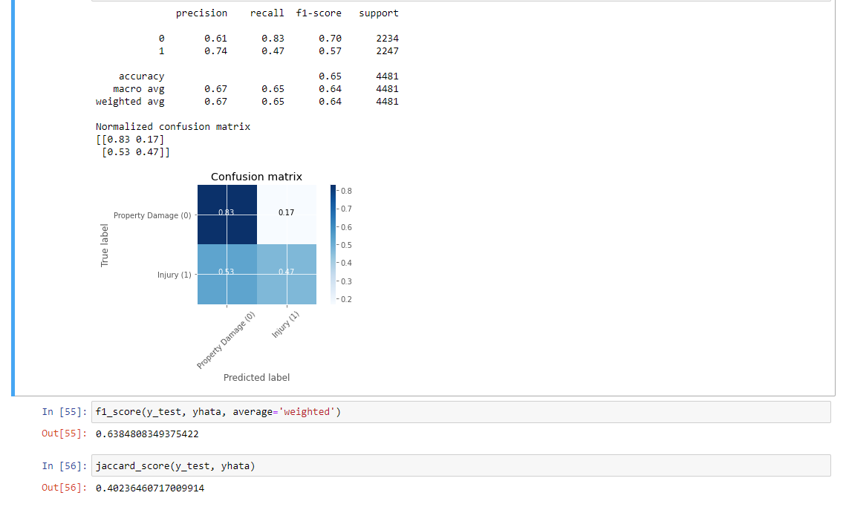
Svm kernel=linear, df_bal, limit=22405

Slide 2
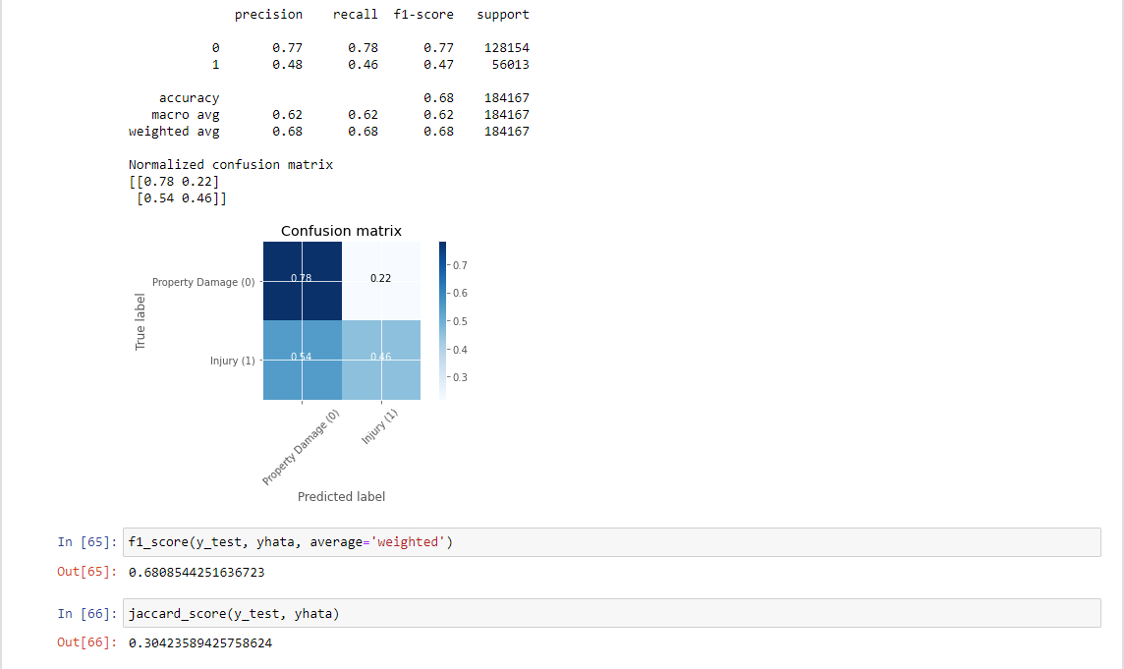
Svm kernel=linear, df, limit=full unbalanced set

Slide 3
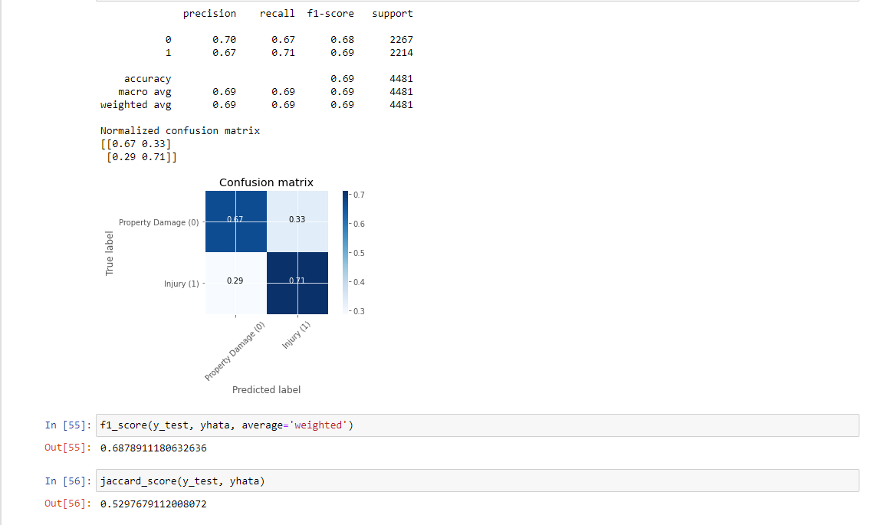
Svm kernel=rbf, df_bal, limit=22405

Slide 4
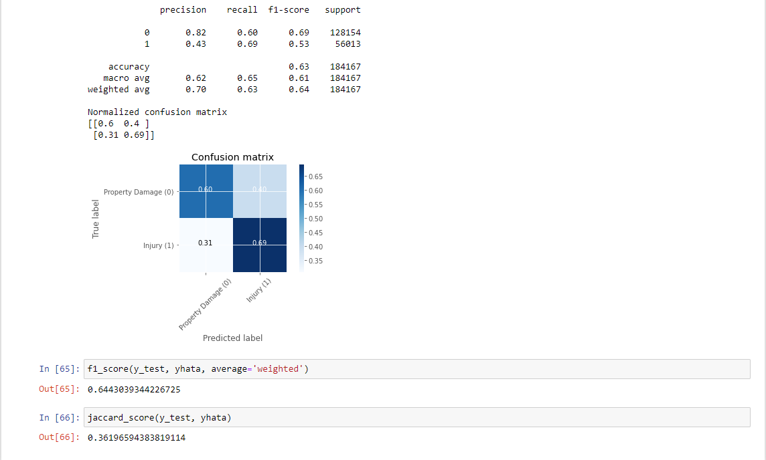
Svm kernel=rbf, df, limit=full unbalanced set

Slide 5
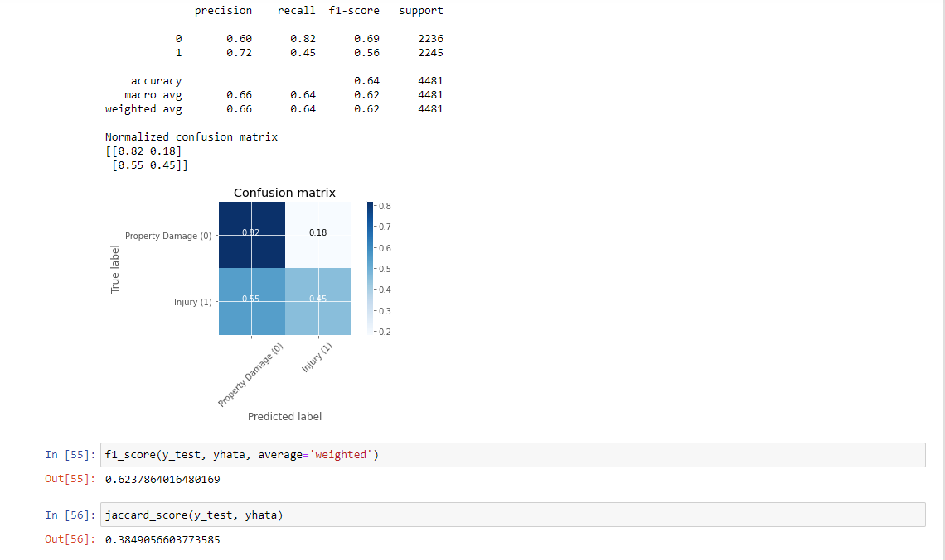
Svm kernel=poly, df_bal, limit=22405

Slide 6

Svm kernel=poly, df, limit=full unbalanced set

Slide 7
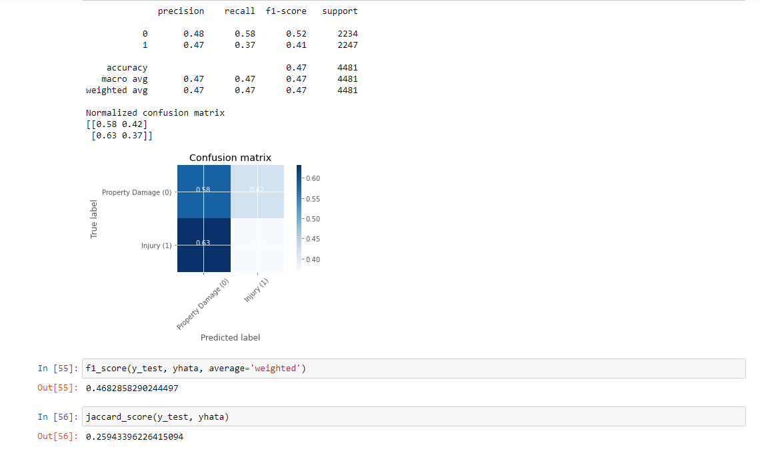
Svm kernel=sigmoid , df_bal, limit=22405

Slide 8
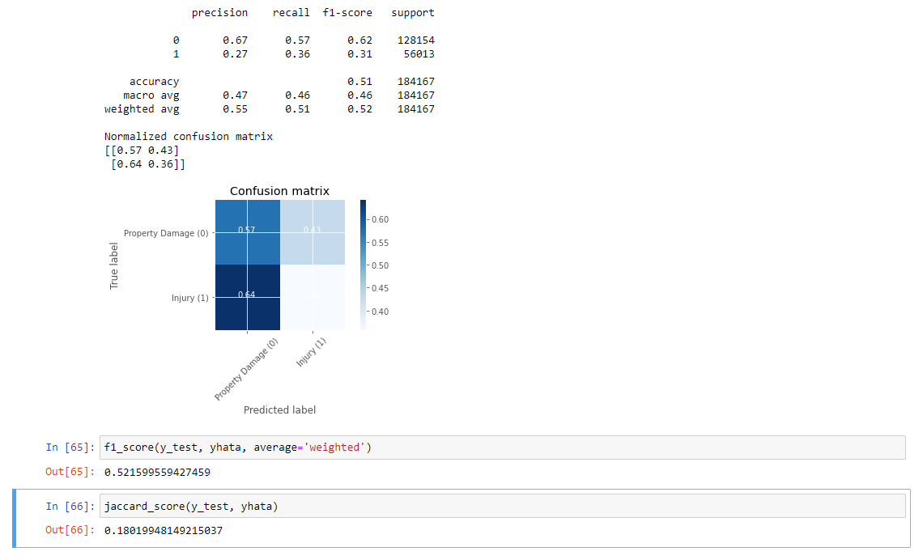
Svm kernel=sigmoid, df, limit=full unbalanced set

Slide 9
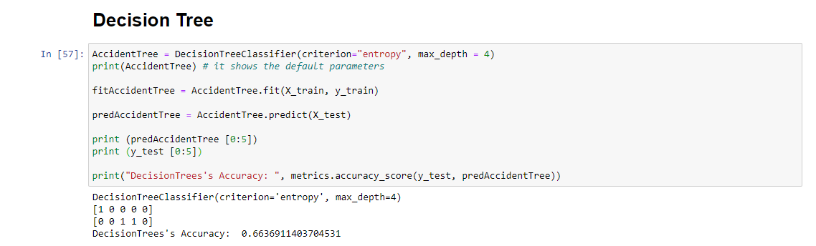

Slide 10
